Slide 1
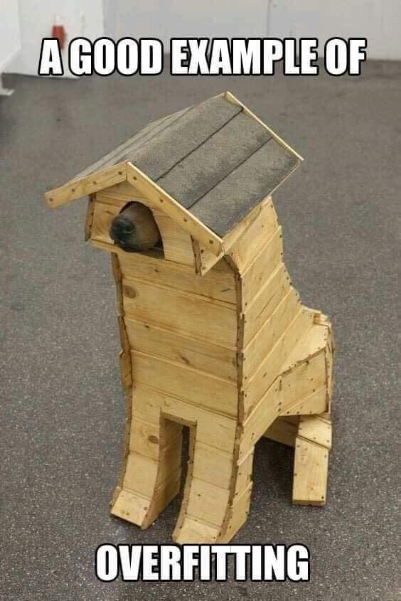
Source

Slide 2
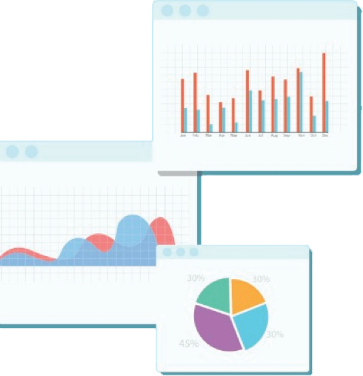

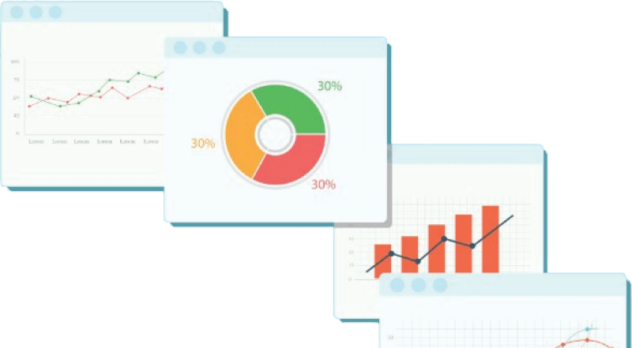
Welcome to Week 6
Lecture 2!
Data Science in Python &
Machine Learning

Slide 3
Announcements
Belt Exam for Stack 2
March 11th - March 13th
Must have attended 80% of classes
Must have passed 90% of assignments
All assignments & resubmits from weeks 1 & 2 are due by Friday at 9am PST (March 11th)
Final Project
Have at least 5 slides with 2 visualizations.
1 slide should state the problem.
2 slides should include visualizations with analyses.
1 slide should include trends or insights you gained from the data.
1 slide should include recommendations for stakeholders.

Slide 4
Learning Goals
After this lesson you will be able to:
Explain bias, variance, and the bias/variance tradeoff.
Visualize how a Tree Based model makes predictions
Use regularization to reduce variance (overfitting) in a Tree Based model.

Slide 5
Introducing the Bias/Variance Tradeoff
Imagine you have a study guide for an upcoming test.
How are you going to use that study guide?
Memorize the study guide?
Focus on just on big ideas?
The effectiveness of your approach will only be known on TEST DAY!

Slide 6
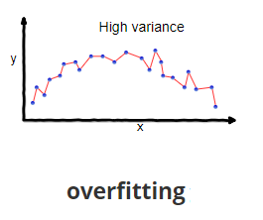
High Variance = OVERfitting
Study approach A (memorize every detail) corresponds to a model with high variance.
You would do perfect on a test that was exactly the same as your study guide.
Notice how this model perfectly predicts each data point IF the “test” is the same as the “study guide”.
But what if there is a question not specifically addressed on your study guide? You have no ability to recognize big ideas to make a valid guess.

Slide 7
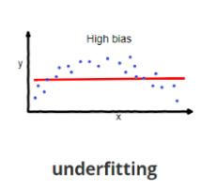
High Bias = UNDERfitting
Approach B (only big ideas and no detail) corresponds to a model with high bias
You would miss any question on the test that involved knowing details.
This model is in a reasonable range of the data.
Notice how this model is so simple that it misses details.
But what if there is a question from the study guide that goes into more detail? You could potentially miss this question because you did not focus on the details.

Slide 8
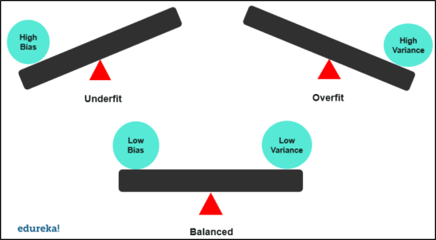
We want a balance!
Source
Notes:
what dove see?

Slide 9
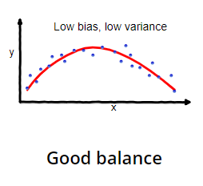
This is a nice balance between the big pattern and the details.
The model found the FUNCTION, but did not fit on the NOISE!

Slide 10
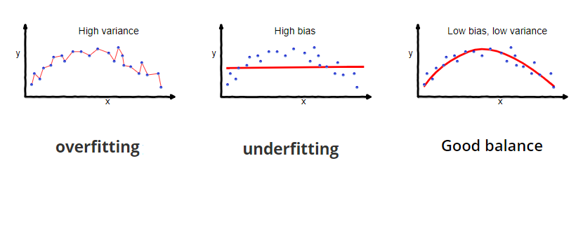
Model is too complex and fits on random noise in the data
Model is too simple
Model is just right and fits on the general function

Slide 11
Bias/Variance Tradeoff:
Decreasing the variance tends to increase the bias of the model

Slide 12
How to identify overfitting?
Train R2 Score | Test R2 Score | Bias/Variance
.30 | .29 | High Bias (underfit)

Slide 13
How to identify overfitting?
Train R2 Score | Test R2 Score | Bias/Variance
.30 | .29 | High Bias (underfit)
.99 | .54 | High Variance (overfit)

Slide 14
How to identify overfitting?
Train R2 Score | Test R2 Score | Bias/Variance
.30 | .29 | High Bias (underfit)
.99 | .54 | High Variance (overfit)
.45 | .14 | High Bias AND Variance

Slide 15
How to identify overfitting?
Train R2 Score | Test R2 Score | Bias/Variance
.30 | .29 | High Bias (underfit)
.99 | .54 | High Variance (overfit)
.45 | .14 | High Bias AND Variance
.95 | .94 | Good Fit

Slide 16

Regularization
Regularization prevents a model from overfitting.
We need to find the RIGHT amount of regularization
to balance the bias and variance.
We call this ‘tuning’ a model
Image Source

Slide 17
Regularization
So your model has high variance, now what?
Regularization prevents a model from memorizing the data and forces it to find the general function instead.
Done differently for different model types, for example:
Decision Trees: Adjust max_depth, min_sample_split, min_sample_leaf or other hyperparameters. Check the documentation for more options.
Random Forests: Adjust n_estimators, max_depth,min_sample_split, min_sample_leaf or other hyperparameters. Check the documentation for more options.
K Nearest Neighbors: Adjust n_neighbors, weights or other hyperparameters. Check the documentation for more options.
Each model type has different ways to regularize it and combat overfitting. Check the documentation for each model type.

Slide 18
The Goal?
Maximize the Testing Metrics!!!
Don’t sacrifice test metrics to decrease variance
High variance means you might be able to do better on the test set if you use regularization.

Slide 19
Implementing Decision Trees
A predictive modeling approach that separates data into classes using a top down approach
Can be used for classification and regression
Regression Trees predict a continuous quantity or numeric output such as $35.98 or 11.41 inches
The sklearn.tree.DecisionTreeRegressor uses mean squared error, friedman mse and mean absolute error.

Slide 20
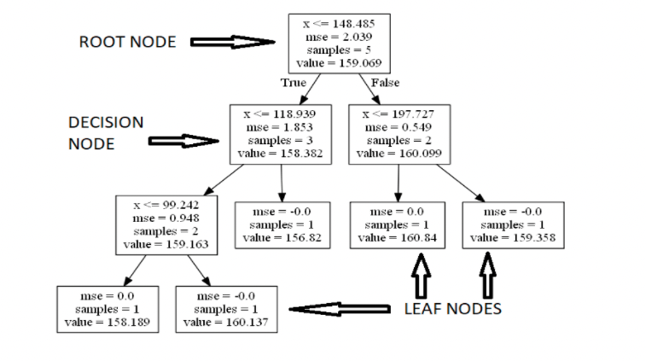
A Simple Decision Tree

Slide 21
Decision Tree Based Models
Advantages
Easy to Interpret
Prediction is fast
Can be used for classification or regression
Doesn’t require scaling
Can be used for multiclass classification problems (more than 2 classes)
Disadvantages
Worse performance than other supervised learning methods
Prone to overfitting
Small variations in the data can result in a completely different tree

Slide 22
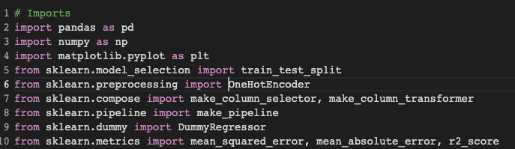
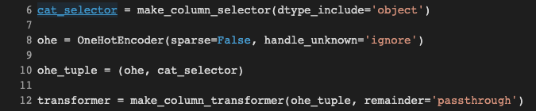

Slide 23
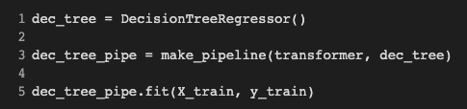
Decision Trees in Python

Slide 24
Bias/Variance Code Along
CodeAlong Notebook

Slide 25
Challenge Notebook

